Slide 1
Income Prediction using Demographic Information.
Team-25
Vinitha Joyce Marathi
Rohit Barve
Lasya Manthripragada

Slide 2
Introduction
This project aims at finding the best model to predict if the income of an individual is greater than 50K based on the data provided by the UCI Machine learning repository called the ‘Adult dataset’ by investigating various pattern recognition techniques.
The data must be classified into two categories >50K and <=50K, which represents income of the individual.
The predictor variables include information such as age, education, occupation, gender, native country and other relevant information of an individual.

Slide 3
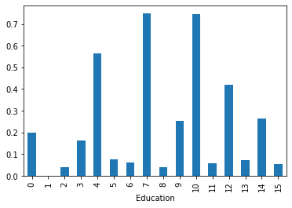
Data Visualization
By these visualizations, we can deduce some correlations between our independent attributes and dependent attribute.
Adults with an educational background of Prof-school (7) and Doctorate (10) will have a better income and it is likely possible that their income is higher than 50K.

Slide 4
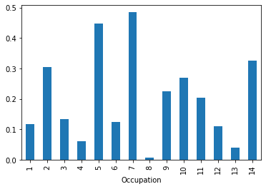
Data Visualization
Our data suggest that people with occupation Prof-specialty (5) and Exec-managerial (7) will have a better chance of earning an income of more than 50K.

Slide 5
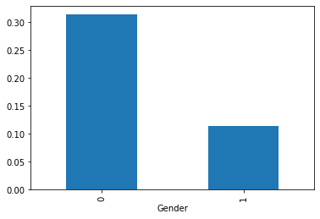
Data Visualization
The gender bar chart provides us some useful insight into the data that Men (0) are more likely to have a higher income.

Slide 6
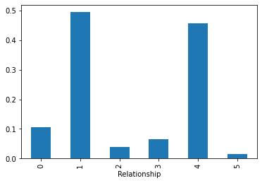
Data Visualization
Relationship chart shows us that wife (1) and husband (4) has a higher income. A married couple would most likely earn >50K.

Slide 7
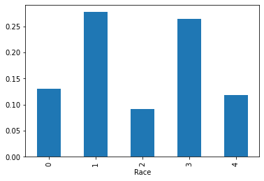
Data Visualization
As per the data, an Asian-Pac-Islander (1) or a white (3) have more chances of earning more than 50K.

Slide 8
Feature Selection
The final dataset contains the following features: edu_num, marital_status, occupation, relationship, race, gender, country, income.
Features like work hours and age are dropped since they have low correlation with target variable ‘income’.
Features capital gain and loss are also dropped since they contain >90% as the value ‘0’ and thus are are redundant in predicting the target variable.

Slide 9
The feature space is of following types:
  Nominal: relationship, marital_status, race, gender, country
  Ordinal: education, occupation
The nominal features are one-hot encoded since they represent individual values and order does not matter.
The ordinal features are mapped to a number which indicates the weight for value of that feature. Education is mapped such that higher the education level higher, the higher the weight assigned.

Slide 10
Model Selection
Gaussian NB
Logistic regression
Random forest
Support Vector Machine

Slide 11
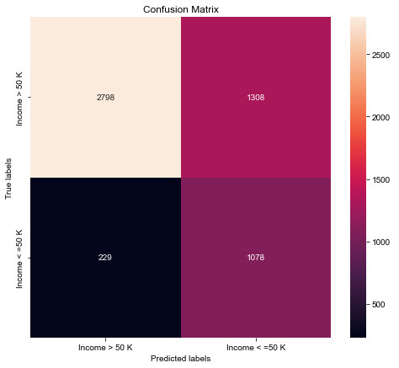
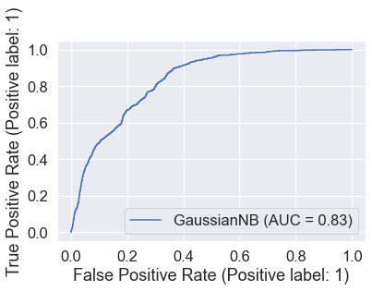
Naive Bayes
Naïve Bayes classification is a straightforward and powerful algorithm for the classification task.

Slide 12
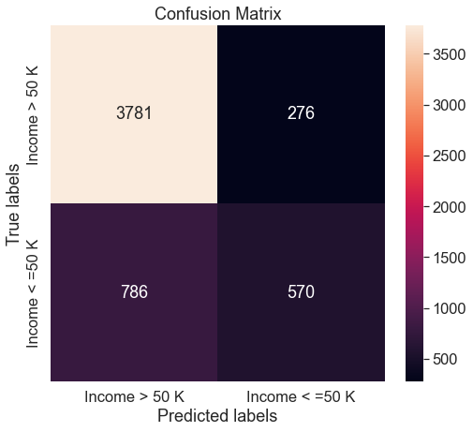
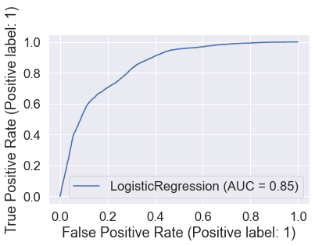
Logistic Regression
Logistic Regression is one of the easiest and most used supervised Machine learning algorithms for categorical classification.

Slide 13
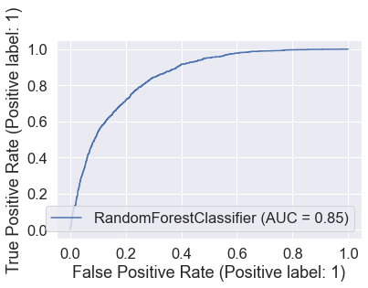
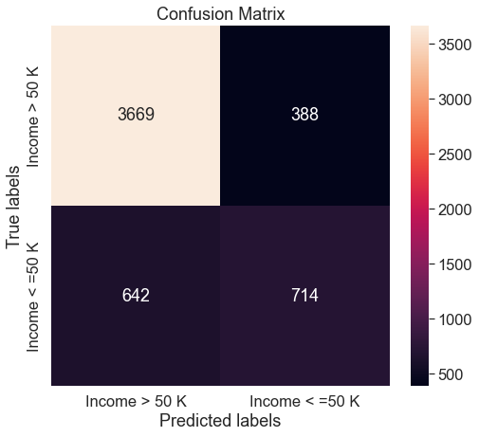
Random forest
Random forests are very flexible and give high accuracy as it overcomes the problem of overfitting by combining the results of multiple decision trees. Even for large datasets, random forests give a good performance.

Slide 14
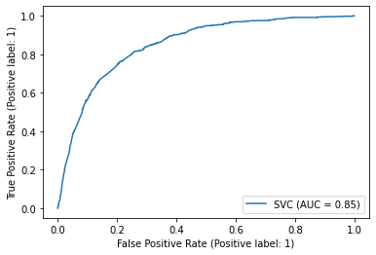
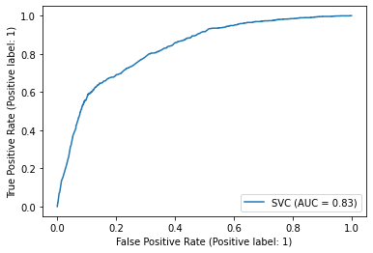
Support Vector Machine
SVMs are effective even in high dimensional feature space. Our training dataset contains 56 features that need to be learned and SVM classifier gives a good accuracy for test data with low variance.
AUC plot ( Linear )
AUC plot ( RBF )

Slide 15
Conclusion: Metrics
Classifier | Train accuracy | Test accuracy | Precision | Recall | F1-score | ROC_AUC Score
Gaussian NB | 0.724 | 0.716 | 0.924 | 0.68 | 0.78 | 0.753
Logistic Regression | 0.808 | 0.809 | 0.827 | 0.93 | 0.875 | 0.84
Random Forest | 0.806 | 0.807 | 0.85 | 0.904 | 0.876 | 0.85
SVM | 0.811 | 0.819 | 0.87 | 0.89 | 0.88 | 0.850

Slide 16
Conclusion
In all experiments, training and test data accuracies are in the same range which implies that there is no overfitting data.
All the models gave almost the same results. No model stood out extraordinarily.
Dataset was highly imbalanced. If we can gather more data, we can improve the performance of the models.
We can also perform PCA for dimensionality reduction to improve the performance.
Relatively, SVM gave the best results. Hence, it is the best fit model.

Slide 17
THANK YOU

